Slide 1
BANGLADESH SEVENTH FIVE YEAR PLAN
FY2016-FY2020
Accelerating Growth, Empowering Every Citizen
Prepared By
INTERNAL RESOURCES DIVISION

Slide 2
Plan Goals and Targets 7th FYP
A. Income and poverty
Attaining average real GDP growth of 7.4% per year over the Plan period.
Reduction in the head-count poverty ratio by 6.2 percentage point.
Reduction in extreme poverty by about 4.0 percentage point.
Creating good jobs for the large pool of under- employed and new labor force entrants by increasing the share of employment in the manufacturing sector form 15 percent to 20 percent.

Slide 3
Plan Goals and Targets 7th FYP
B. Sector Development
Increase the contribution of the manufacturing sector to 21% of GDP by FY20.
Substantial improvement of export to $54.1 billion by FY20.
Achieving a Trade0GDP ratio of 50% by FY20.

Slide 4
Plan Goals and Targets 7th FYP
C. Macroeconomic Development
Total revenue to be raised from deficit of 5% of GDP.
Government spending to be increased to 21.1% of GDP by FY20.
FDI to be increased substantially to $9.6 billion by FY20.

Slide 5
Plan Goals and Targets 7th FYP
D. Urban Development
Access to improved water source will be ensured for all urban dwellers.
Coverage of drainage system to be expanded to 80%
Ensure sustainable urban development that supports increased productivity, investment and employment.

Slide 6
Plan Goals and Targets 7th FYP
E. Human Resource Development (Education, Health and Population)
Achieving 100 percent net enrollment rate for primary and secondary education.
Increasing enrollment rate in 12th class to 60%.
Percentage of cohort reaching grade 5 to be increased to 10 from current 80 percent.

Slide 7
Plan Goals and Targets 7th FYP
F. Water and Sanitation
Safe drinking water to be made available for all urban population.
Safe drinking water to be made available for all rural population

Slide 8
Plan Goals and Targets 7th FYP
G. Energy and Infrastructure
Installed Generation Capacity of electricity to be increased to 23,000 MW by 2020.
Increase per capita energy consumption from 371 kWh to 514 kWh.
Electricity coverage to be increase to 96 percent.

Slide 9
Plan Goals and Targets 7th FYP
H. Gender equality, income inequality and social protection
Female to male ratio in tertiary education to be raised from current 70 percent to 100 percent.
The ratio of literate female to male for age group 20-24 to be raised to 100 percent from the current 86 percent.

Slide 10
Plan Goals and Targets 7th FYP
I. Environmental Sustainability
Increase productive forest coverage to 20 percent.
Improve air quality in Dhaka and other large cities and enact Clean Air Act.

Slide 11
Plan Goals and Targets 7th FYP
J. ICT Development
Spending on Research and Development to constitute 1% of GDP.
Increase proportion of primary government schools with a computer laboratory.
Improve teledensity to 100%.

Slide 12
GDP Growth Chart
Specific plan | Plan Periods (FY) | Average GDP Growth Rate |  | Ratio of actual to plan | Per Capita GDP growth
 |  | Plan (%) | Actual(%) | (%) | (%)
First Plan | 1973-1978 | 5.5 | 4.0 | 73 | 1.3
Second Plan | 1980-1985 | 5.4 | 3.8 | 70 | 1.5
Third Plan | 1985-1990 | 5.4 | 3.8 | 70 | 1.6
Fourth Plan | 1990-1995 | 5.0 | 4.2 | 84 | 2.4
Fifth Plan | 1995-2000 | 7.1 | 5.1 | 72 | 3.5
Sixth Plan | 2000-2005 | 7.3 | 6.3 | 86 | 4.9
Source: BBS

Slide 13
Per Capita GDP in US Dollar

Slide 14
Bangladesh Sixth plan Growth Performance in International Context (% p.a. 2011-2015)

Slide 15
Structural Change in Economy(% of GDP)
Structure of the Economy | FY2010 | FY2015
Agriculture | 17.81 | 15.59
Industry | 26.14 | 27.98
-of which Manufacturing | 16.89 | 20.17
Services | 56.05 | 56.42
Sources: BBS

Slide 16
Estimated Job Creation in the Sixth Plan (million workers)
 | FY2020 (Base Year) | FY2015 (Estimated) | FY2015 (Adjusted Plan Target)
Domestic Employment
-Agriculture | 25.7 | 24.4 | 24.5
-Manufacturing | 6.7 | 9.6 | 10.0
-Other industry | 2.8 | 4.3 | 4.4
-Services & Others | 18.9 | 23.1 | 24.4
Total Domestic Employment | 54.1 | 61.4 | 63.3
Source: GED Estimates

Slide 17
Projected Reduction in Poverty during the Sixth Plan Period(%)
Year | Poor(Head Count Poverty with Upper Poverty Line(%) | Extreme Poor(Head Count with Lower Poverty Line(%)
2011 | 29.9 | 16.5
2012 | 28.4 | 15.4
2013 | 27.2 | 14.6
2014 | 26.0 | 13.7
2015 | 24.8 | 12.9
Source: GED estimates based on 2005-2010 GDP-Poverty Relationship

Slide 18
Sixth Plan Key Targets of the Macroeconomic Framework
Policy Area | Performance Indicators | Baseline (FY2010) | Plan (FY2015) | Actual (FY2015)
Fiscal Policy | Tax to GDP ratio(%) | 7.8 | 12.4 | 9.3
 | Fiscal Deficit(%GDP) | 3.4 | 5.0 | 5.0
Source: Sixth Plan and GED Estimates

Slide 19
Progress with Infrastructure development
Access to electricity from the FY2010 baseline of 48% to 72% in FY2015
Per capita electricity increased 220 kWh to 371 kWh

Slide 20
Macroeconomic Development
Total revenue to be raised from 10.7% of GDP to 16.1% by FY20
Maintain the current fiscal deficit of 5% of GDP
Government spending to be increased to 21.1% of GDP by FY20
FDI to be substantially to $9.6% billion by FY20

Slide 21
7th Five Year Plan Targets
Targets | Base Year 2010 | Progress under 6th FYP 2015 | 7th FYP 2020
Real GDP Growth(%) | 6.1 | 6.5 | 8
Head Count Poverty(%) | 31.5 | 24.8 | 18.6
Growth in agriculture(%) | 6.15 | 3.04 | 3.34
Growth in industry(%) | 7.03 | 9.6 | 10.9
Growth in services(%) | 5.53 | 5.83 | 6.49
Total Revenue(% of GDP) | 9.98 | 10.7 | 16.1
NBR Tax Revenue (% of GDP) | 8.03 | 9.0 | 13.7
Fiscal Deficit(% of GDP) | 3.3 | 4.7 | 4.7
Continued……

Slide 22
7th Five Year Plan Targets
Targets | Base Year 2010 | Progress under 6th FYP 2015 | 7th FYP 2020
Total Government Spending (% of GDP) | 13.88 | 15.7 | 21.1
National Savings (% of GDP) | 29.44 | 29.01 | 32
Gross Domestic Investment (% of GDP) | 26.25 | 28.97 | 34.4
Access to improved sanitation facilities (% of population) | 53 | 57 | 100
Income Inequality(Gini coefficient) | 0.458 | 2.02 | 2.3

Slide 23
Post-2015 Sustainable Development Goals(SDGs) a proposed by the Open Working Group(OWG)
SDG 1 End Poverty in all its forms everywhere
SDG 2 End hunger, achieve food security and improved nutrition, and promote sustainable agriculture
SDG 3 Ensure healthy lives and promote well-being for all at all ages
SDG 4 Ensure inclusive and equitable quality education and promote life-long learning opportunities for all
Continued……

Slide 24
Post-2015 Sustainable Development Goals(SDGs) a proposed by the Open Working Group(OWG)
SDG 5 Achieve gender quality and empower all women and girls
SDG 6 Ensure availability and sustainable management of water and sanitation for all.
SDG 7 Ensure access to affordable, reliable, sustainable, and modern energy for all
Continued……

Slide 25
Post-2015 Sustainable Development Goals(SDGs) a proposed by the Open Working Group(OWG)
SDG 8 Promote sustained, inclusive and sustainable economic growth, full and productive employment and decent work for all
SDG 9 Build resilient infrastructure, promote inclusive and sustainable industrialization and foster innovation

Slide 26
Post-2015 Sustainable Development Goals(SDGs) a proposed by the Open Working Group(OWG)
SDG 10 Reduce inequality within and among countires
SDG 11 Make cities and human settlement inclusive, safe, resilient and sustainable
SDG 12 Ensure sustainable consumption and production patterns
SDG 13 Take urgent action to combat climate change and its impacts
Continued……

Slide 27
Post-2015 Sustainable Development Goals(SDGs) a proposed by the Open Working Group(OWG)
SDG 14 Conserve and sustainably use the oceans, seas and marine resources for sustainable development
SDG 15 Protect, restore and promote sustainable use of terrestrial ecosystems, sustainably manage forests, combat desertification, and halt and reverse and degradation and halt biodiversity loss
Continued……

Slide 28
Post-2015 Sustainable Development Goals(SDGs) a proposed by the Open Working Group(OWG)
SDG 16 Promote peaceful and inclusive societies for sustainable development, provide access to justice for all and build effective, accountable and inclusive institution at all levels
SDG 17 Strengthen the means of implementation and revitalize the global partnership for sustainable development

Slide 29
Bangladesh: Key Economic Indicators, FY15 to FY20
Components | FY15 | FY16 | FY17 | FY18 | FY19 | FY20 |  | Average (FY16-20)
 | Est. | Projection
Real GDP Growth | 6.5 | 7.0 | 7.2 | 7.4 | 7.6 |  | 8.0 | 7.4
Gross Investment | 28.9 | 30.1 | 31.0 | 31.8 | 32.7 |  | 34.4 | 32.0
National Savings | 29.0 | 28.9 | 29.5 | 30.0 | 30.5 |  | 31.9 | 30.2
Total Revenue | 10.8 | 12.1 | 13.5 | 14.3 | 15.1 |  | 16.1 | 14.2
Tax Revenue | 9.3 | 10.6 | 11.5 | 12.3 | 13.1 |  | 14.1 | 12.3
Non-Tax Revenue | 1.5 | 1.5 | 2.0 | 2.0 | 2.0 |  | 2.0 | 1.9
Sources: BBS, Bangladesh Bank, Ministry of Finance and Seventh Plan Projection, GED

Slide 30
Bangladesh: Central Government Operations, FY15 to FY20
Components | FY15 | FY16 | FY17 | FY18 | FY19 | FY20 | Average (FY16-20)
 | Est. | Projection
 | (in )
Total Revenue | 1633 | 2084 | 2635 | 3171 | 3809 | 4627 | 3265.2
Tax Revenue | 1406 | 1822 | 2244 | 2728 | 3304 | 4052 | 2830.2
NBR Tax Revenue | 1350 | 1764 | 2166 | 2639 | 3203 | 3937 | 2741.9
Non-Tax Revenue | 227 | 262 | 390 | 444 | 504 | 575 | 435.0
Sources: Ministry of Finance and Seventh Plan Projection

Slide 31
Bangladesh: Central Government Operations, FY15 to FY20
Components | FY15 | FY16 | FY17 | FY18 | FY19 | FY20 | Average (FY16-20)
 | Est. | Projection
 | (in Percent of GDP)
Total Revenue and Grants | 11.2 | 12.5 | 13.9 | 14.7 | 15.5 | 16.5 | 14.6
Total Revenue | 10.8 | 12.1 | 13.5 | 14.3 | 15.1 | 16.1 | 14.2
Tax Revenue | 9.3 | 10.6 | 11.5 | 12.3 | 13.1 | 14.1 | 12.3
NBR Tax Revenue | 8.9 | 10.3 | 11.1 | 11.9 | 12.7 | 13.7 | 11.9
Non-Tax Revenue | 1.5 | 1.5 | 2.0 | 2.0 | 2.0 | 2.0 | 1.9

Slide 32
Bangladesh: Central Government Operations, FY15 to FY20
Components | FY15 | FY16 | FY17 | FY18 | FY19 | FY20 | Average (FY16-20)
 | Est. | Projection
 | (in billions of Taka)
External | 1.1 | 1.4 | 1.2 | 1.2 | 1.1 | 1.0 | 1.2
Domestic | 3.6 | 3.3 | 3.4 | 3.5 | 3.6 | 3.7 | 3.5
Bank | 2.2 | 2.1 | 2.2 | 2.3 | 2.4 | 2.5 | 2.3
Non-Bank | 1.4 | 1.2 | 1.2 | 1.2 | 1.2 | 1.2 | 1.2

Slide 33
Revenue-SFYP Targets and Actual
 | FY 11 |  | FY 12 |  | FY 13 |  | FY 14 |  | FY 15 |  | Average (FY 11-15)
As % of GDP | SFYP | Actual | SFYP | Actual | SFYP | Actual | SFYP | Actual | SFYP | Actual | SFYP | Actual
Total revenue | 12.1 | 10.2 | 13.2 | 10.8 | 13.4 | 10.7 | 14 | 10.4 | 14.6 | 10.8 | 13.5 | 10.6
Tax revenue | 10 | 8.7 | 10.6 | 9 | 11.2 | 9 | 11.8 | 8.6 | 12.4 | 9.3 | 11.2 | 8.9
NBR Taxes | 9.6 | 8.3 | 10 | 8.7 | 11 | 8.6 | 11 | 8.3 | 12 | 8.9 | 11 | 8.6
Non-tax revenue | 2 | 1.5 | 2.5 | 1.8 | 2.2 | 1.7 | 2.2 | 1.8 | 2.2 | 1.5 | 2.2 | 1.7
Source: SFYP Documents and NBR

Slide 34
Financing of total public sector outlays during the seventh plan
Social Sector Spending
Investment Programme

Slide 35
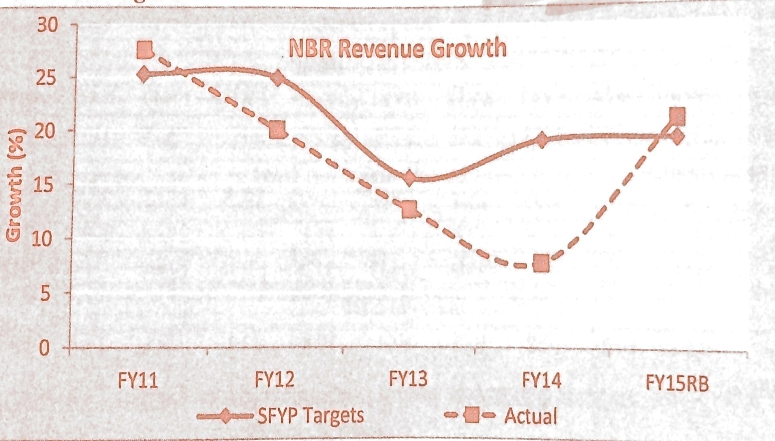
NRB Revenue Growth under the Sixth Plan

Slide 36
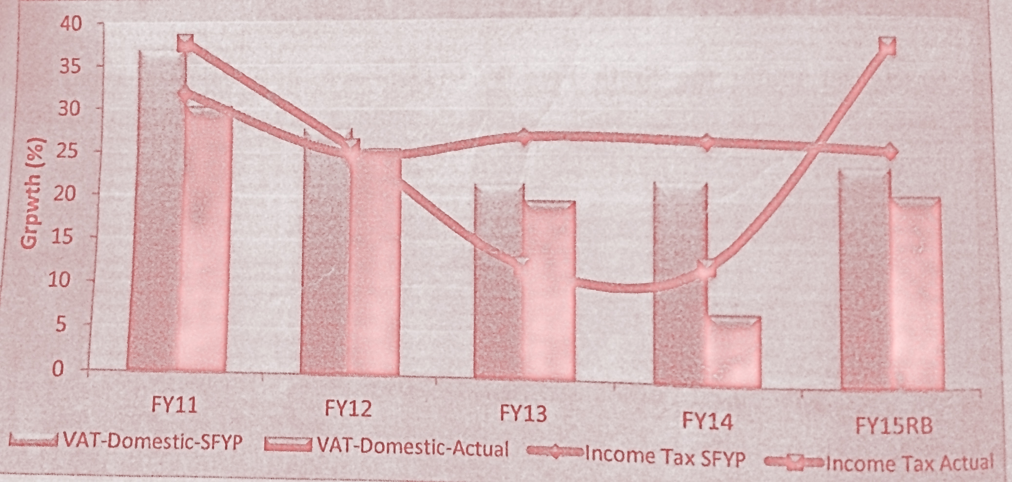
Growth in Tax Components under the Sixth Plan

Slide 37
Growth in Tax Revenue in Recent years
 | FY06 | FY07 | FY08 | FY09 | FY10 | FY11 | FY12 | FY13 | FY14 | FY15
Tax Revenue Growth (%) | 13.4 | 10.0 | 26.6 | 11.5 | 17.4 | 27.5 | 19.4 | 14.8 | 10.7 | 12.8
Average | 15.8 |  |  |  |  | 17.1
Source: National Board of Revenue

Slide 38
Tax Reform Programs Completed During the Sixth FYP
Tax Administration Reform: Income Tax
    Establishing 13 new Income Tax Zones, 2 Tax Appeal Zones and 85 Circle Offices
    Automation of TIN registration and linking TIN with National ID
    Tax calculator installed on the NBR website(www.nbr-bd.org)
    Payment of taxes using the Q-Cash network under the platform of e-payment of NBR
    Establishing taxpayer information and service centers at all divisions
    Providing enhanced taxpayer services through spot assessment, income tax fair etc.
    E-filing of income tax returns on a pilot basis(LTU)
    Introducing incentive based taxation system through tax cards, certificates etc. for tax compliance
    Strengthening the Central Intelligence Cell (CIC) for combating tax evasion

Slide 39
Tax Reform Programs Completed During the Sixth FYP
Tax Administration Reforms: VAT and Customs
    Establishing 4 new VAT Commissionerates and 3 VAT Appeal Commissionerates,
    Setting up of 1 new Custom House (ICD), merger of Import and Export Wings of Chittagong Custom House, setting up of a full-blown Commissionerate at Chittagong
    Installing ASYCUDA World System in all Custom Houses and 4 Land Custom Stations
    Online connectivity between the customs database and Bangladesh Bank database for combating money laundering
    Developing customs database
    E-filing of VAT returns on a pilot basis at Large Taxpayers Units(LTUs)

Slide 40
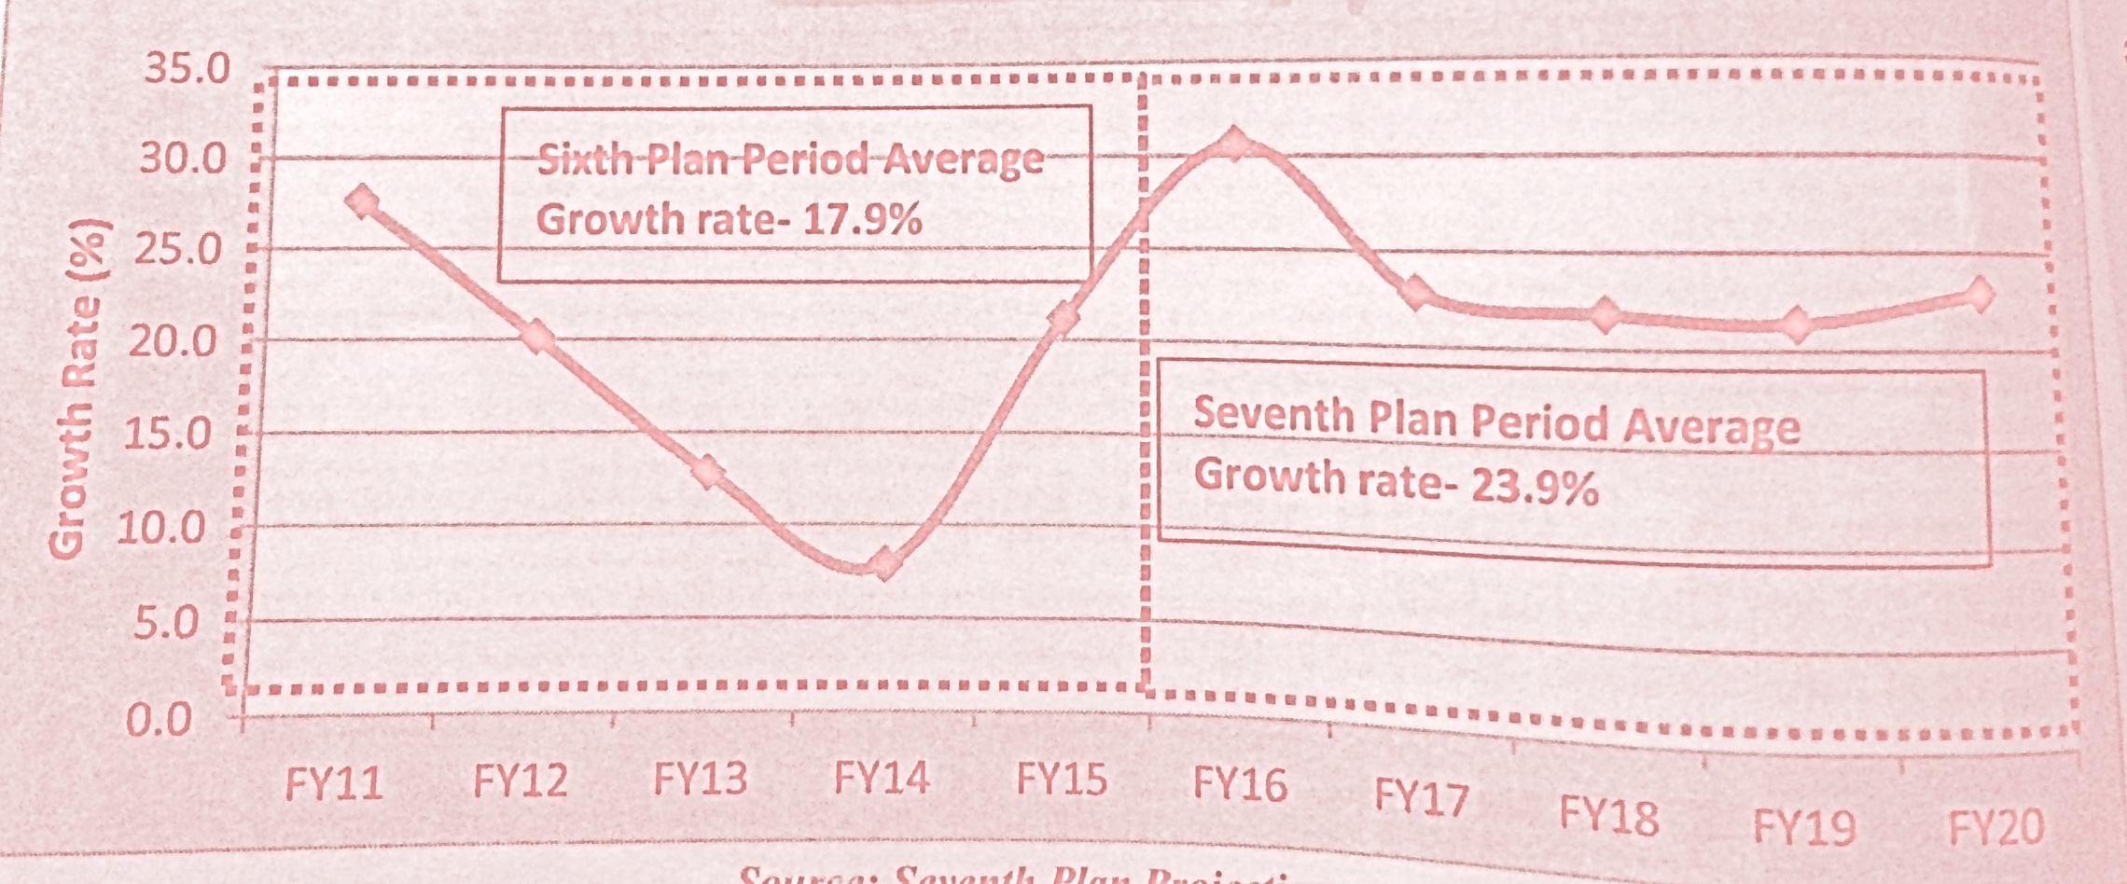
Growth in Tax Revenues under 7th Plan Compared with the Sixth Plan

Slide 41
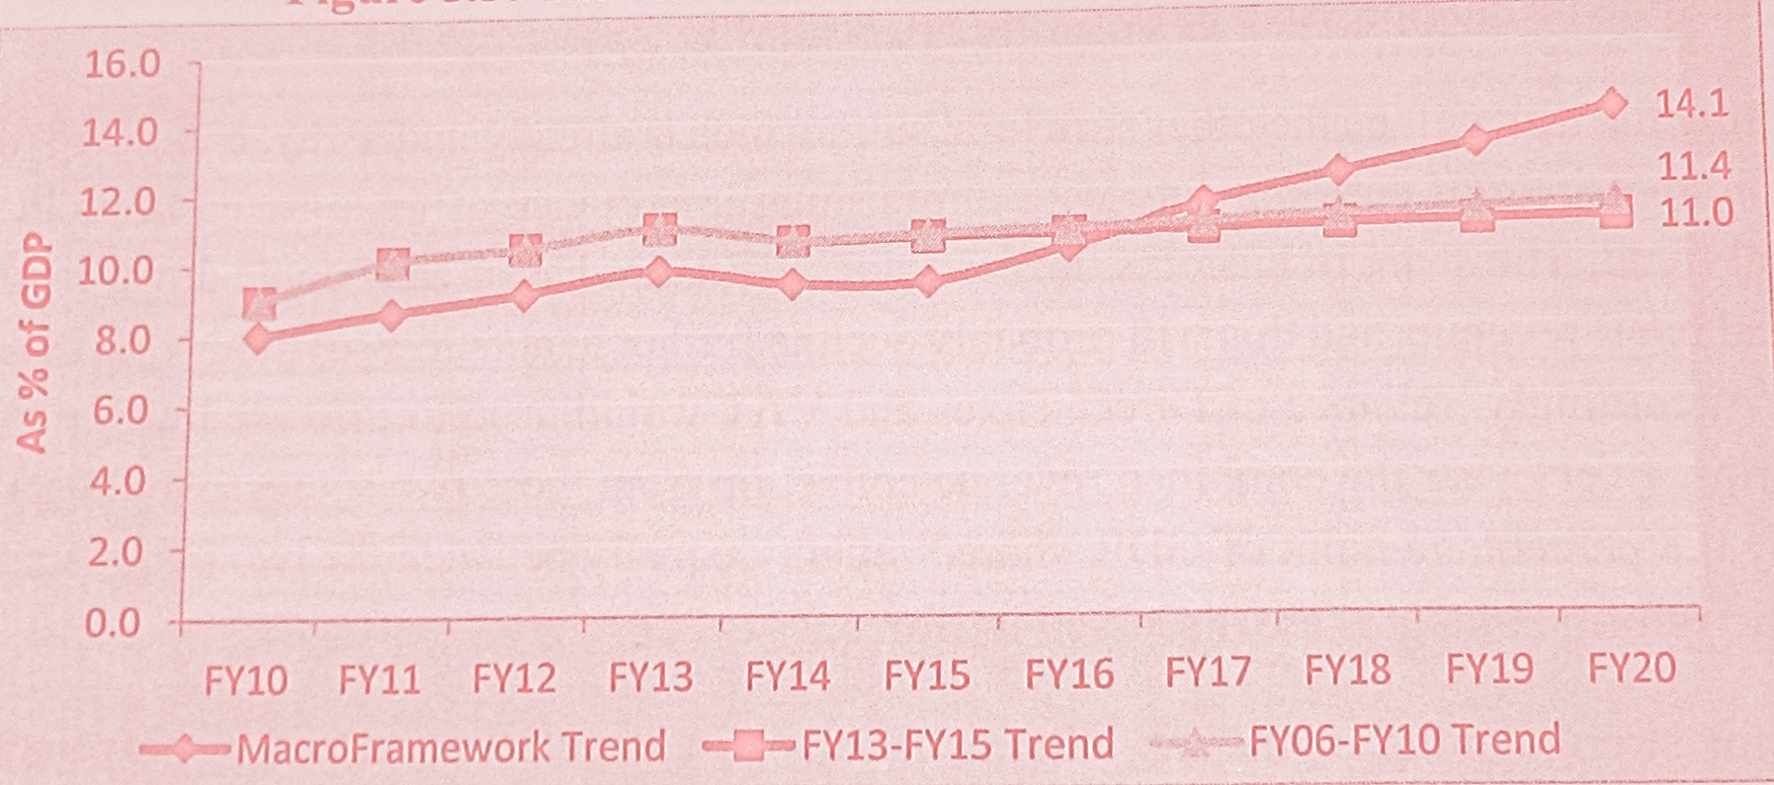
Tax-GDP Ratios under Various Scenarios

Slide 42
Revenue Structure in the Seventh Five Year Plan Period(FY16-FY20)
As% of GDP | FY14 | FY15 | FY16 | FY17 | FY18 | FY19 | FY20
 | Actual | Revised Budget | 7FYP Period
Total Revenue | 10.4 | 10.8 | 12.1 | 13.5 | 14.3 | 15.1 | 16.1
Total Tax Revenue | 8.6 | 9.3 | 10.6 | 11.5 | 12.3 | 13.1 | 14.1
NBR Tax Revenue | 8.3 | 8.9 | 10.3 | 11.1 | 11.9 | 12.7 | 13.7
Source: National Board of Revenue

Slide 43
Major Components of Revenue in the Seventh Five Year Period(FY16-FY20)
As% of GDP | FY14 | FY15 | FY16 | FY17 | FY18 | FY19 | FY20
 | Actual | Revised Budget | 7FYP Period
Customs Duty | 1.0 | 1.0 | 1.1 | 1.2 | 1.2 | 1.2 | 1.3
VAT+SD | 4.5 | 4.6 | 5.4 | 5.7 | 6.4 | 6.6 | 7.0
Income Tax | 2.6 | 3.2 | 3.7 | 4.1 | 4.3 | 4.9 | 5.4
Others | 0.1 | 0.1 | 0.1 | 0.1 | 0.1 | 0.1 | 0.1
Non-NBR Tax | 0.3 | 0.4 | 0.3 | 0.4 | 0.4 | 0.4 | 0.4
Non-Tax Revenue | 1.8 | 1.5 | 1.5 | 2.0 | 2.0 | 2.0 | 2.0
Source: National Board of Revenue and Seventh Plan Projection

Slide 44
NBR Tax Reform Required for Attaining Tax Targets in the Seventh Five Year Plan
Tax Policy Reforms
Effective Implementation of VAT and Supplementary Duty Act 2012
Incorporating transfer pricing in the Income Tax Ordinance, 1984
Incorporating Alternative Dispute Resolution (ADR) in Income Tax, VAT and custom Acts
Drafting of a new Direct Tax Code
Drafting of a new Customs Act

Slide 45
NBR Tax Reform Required fo Attaining Tax Targets in the Seventh Five Year Plan
Tax Administration Reforms: Income Tax
Broadening of the taxpayers’ base
Broadening of the tax revenue sources
Focusing on income from service providers and self-employed (who are difficult to tax)
Treating all sources of income equally for the tax purpose without discrimination for the households
Automation of TIN registration and linking TIN with National I.D
Integrated Revenue Management Programme: Digitalization Programme
E-Filling of income tax returns
Aggressive imposition and expansion of withholding taxes
Strategic Communication and Taxpayer Outreach, Education and Assistance

Slide 46
Tax Administration Reforms: VAT and Custom
Implementation of the new VAT Act.
Expanding VAT base especially on business and organization
Incentivizing VAT Payment with benefits for small businesses to bring them into the VAT coverage as well as promoting increased formalization of businesses currently operating in the informal sector.
Reform of the VAT Administration along functional lines
Automation of the whole tax administration through central Data base including central VAT Registration; electronic submission and return processing
Comprehensive taxpayers’ education and information campaign about the new VAT law and Rules.

Slide 47
Fiscal Deficit and Financing under Seventh Five Year Plan
As % of GDP | FY 14 | FY 15 | FY 16 | FY 17 | FY 18 | FY 19 | FY 20
 | Actual | Revised Budget | 7 FYP Period
Fiscal Deficit (including Grants) | -3.1 | -4.7 | -4.7 | -4.6 | -4.7 | -4.7 | -4.7
Financing | 3.1 | 4.7 | 4.7 | 4.6 | 4.7 | 4.7 | 4.7
Domestic Borrowing | 2.8 | 3.6 | 3.3 | 3.4 | 3.5 | 3.6 | 3.7
-Bank | 1.4 | 2.2 | 2.1 | 2.2 | 2.3 | 2.4 | 2.5
-Non-Bank | 1.5 | 1.4 | 1.2 | 1.2 | 1.2 | 1.2 | 1.2
External Borrowing (net) | 0.3 | 1.1 | 1.4 | 1.2 | 1.1 | 1.1 | 1.0
Source: Seventh Plan Projection based on Budget FY16 data

Slide 48
Ministry-Wise Annual Development Program Allocation in the Seventh Plan: ADP by Ministry(FY16-FY20)
 |  |  | ADP in current Prices
No. | Sector | Ministry Division | FY 16 | FY 17 | FY 18 | FY 19 | FY 20
1 | General Public Services | Internal Resource Division | 4.6 | 6.8 | 8.1 | 9.5 | 11.1
2 | Environment and Climate Change | Ministry of Environment and Forests | 4.8 | 7.3 | 8.6 | 10.1 | 11.9
Total development Expenditure |  |  | 9.4 | 14.1 | 16.7 | 19.6 | 23

Slide 49
Development Results Framwork(DRF) For Monitoring The Seventh Five Year Plan(2016-2020)
Performance Indicators | Baseline (Year) | Target (2016) | Target (2017) | Target (2018) | Target (2019) | Target (2020)
Real Sector
Real GDP growth (%) | 6.5 (FY, 2015) | 7.0 | 7.2 | 7.4 | 7.6 | 8.0
Fiscal Sector
Total Revenue (as % of GDP) (a) Tax Revenue (as% of GDP)
 | 10.8 (FY 2015) (a) 9.3 FY 2015) | 12.1 (a)10.6 | 13.5 11.5 | 14.3 12.3 | 15.1 13.1 | 16.1 14.1

Slide 50
Thank You

